Slide 1

Chinook Music Store Analysis
By
Paturi Abhiram

Slide 2
Table of Contents
Problem Statement
Data Description
Introduction
Approach
Key Insights From Given Tasks
Strategies For Customer Retention
Conclusion

Slide 3
Problem statement
You are hired as a data analyst at Chinook, and your objective is to analyze music record sales data to gain insights and make recommendations for the company's strategy in the physical music market.

Slide 4
Data Description
The data provided consists of 11 tables
Employee
Customer
Invoice.
Invoice Line
Track
Album
Artist
Playlist
Playlist Track
Media Type
Genre

Slide 5
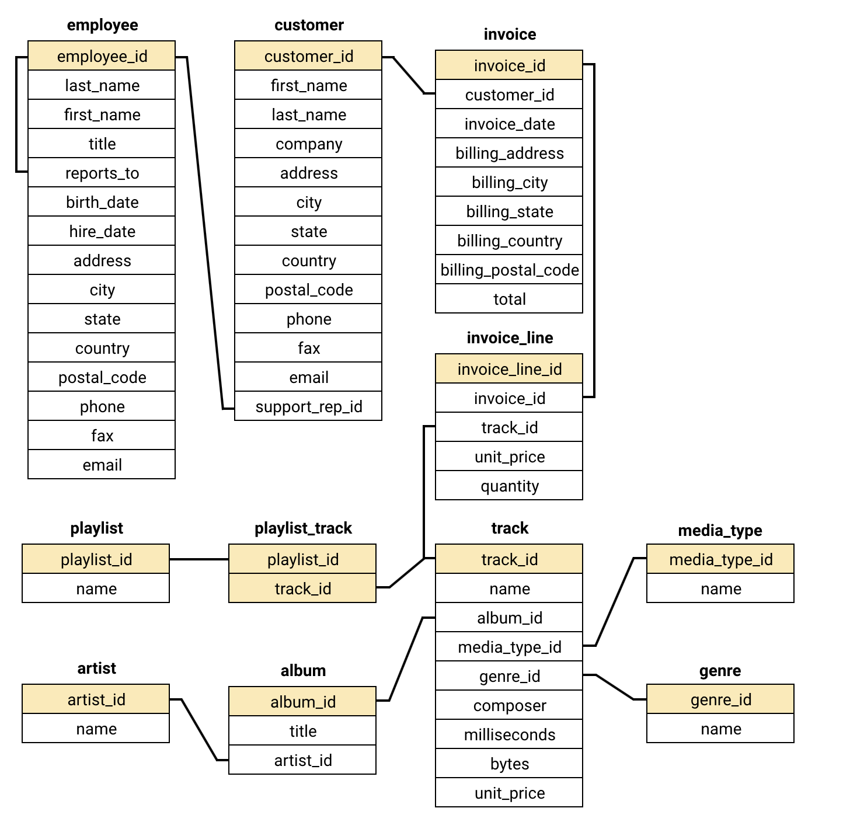

Slide 6
Introduction
Key Goals:
Assess data quality and prepare the dataset.
Identify top-selling tracks, artists, and genres.
Understand customer demographics, behavior, churn, and lifetime value.
Explore regional differences and product affinities for cross-selling.
Derive actionable recommendations for marketing, retention, and promotion.
Why It Matters: Leveraging data-driven insights enables the optimization of inventory management, the customization of promotional strategies, the enhancement of customer loyalty, and the development of informed business decisions within a highly competitive music retail landscape.

Slide 7
Approach
Understand Business Context: Review Chinook domain (music retail), stakeholders, and key questions.
Data Exploration & Preparation: Examine tables (Customer, Invoice, Track, etc.), check for nulls/duplicates, apply cleaning (COALESCE, de-duplication).
SQL-Driven Analysis: Write queries for aggregations and joins to uncover top-selling items, demographics, regional revenue, and churn.
Segmentation & Modeling: Use RFM and CLV calculations to segment customers (Loyal, Regular, Risky) and compute churn rates relative to max invoice date.

Slide 8
Affinity & Trend Analysis: Perform co-purchase (product affinity) analysis, genre/artist popularity trends, and country-wise comparisons.
Visualization & Interpretation: Generate charts (bar, pie, histograms) to illustrate findings and support storytelling.
Actionable Insights & Recommendations: Translate analytical results into targeted marketing, retention, and promotional strategies.

Slide 9
Strategies For Customer Retention
Segmented Re-Engagement Campaigns
Use RFM/CLV segmentation to identify “At Risk” and “High Risk” customers.
Send personalized offers (e.g., discounts on favorite genres/artists) to re-activate inactivity.
Loyalty & Rewards Programs
Reward frequent buyers with points or exclusive access (e.g., early album releases, limited editions).
Tiered benefits: higher tiers for high CLV customers (e.g., free shipping, special bundles).

Slide 10
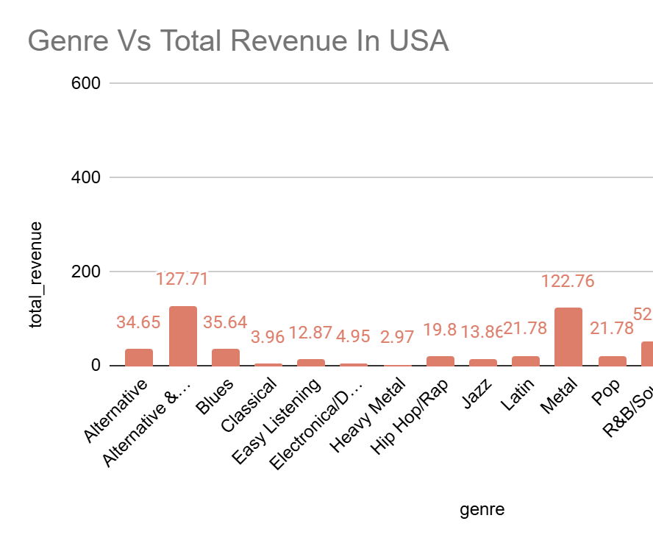
Key Insights From Given Tasks
Rank genres based on their sales performance in the USA
Rock dominates the US market both in track count and revenue.
Alternative & Punk and Metal follow closely in popularity.
Niche genres like TV Shows, Soundtrack, and Heavy Metal have minimal sales.

Slide 11
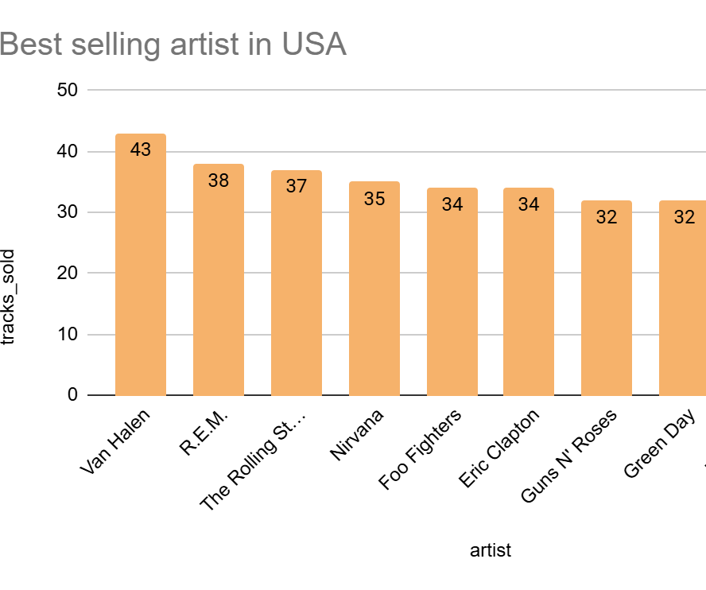
Key Insights From Given Tasks
Best-Selling Artists in the USA
Classic rock and alternative rock dominate Van Halen, Rolling Stones, and Nirvana all feature prominently.
Consistency in sales is seen across top bands, with many clustered in the 30–40 range.
These artists align with top genres like Rock, Alternative & Punk, and Metal, reinforcing earlier findings.
.

Slide 12
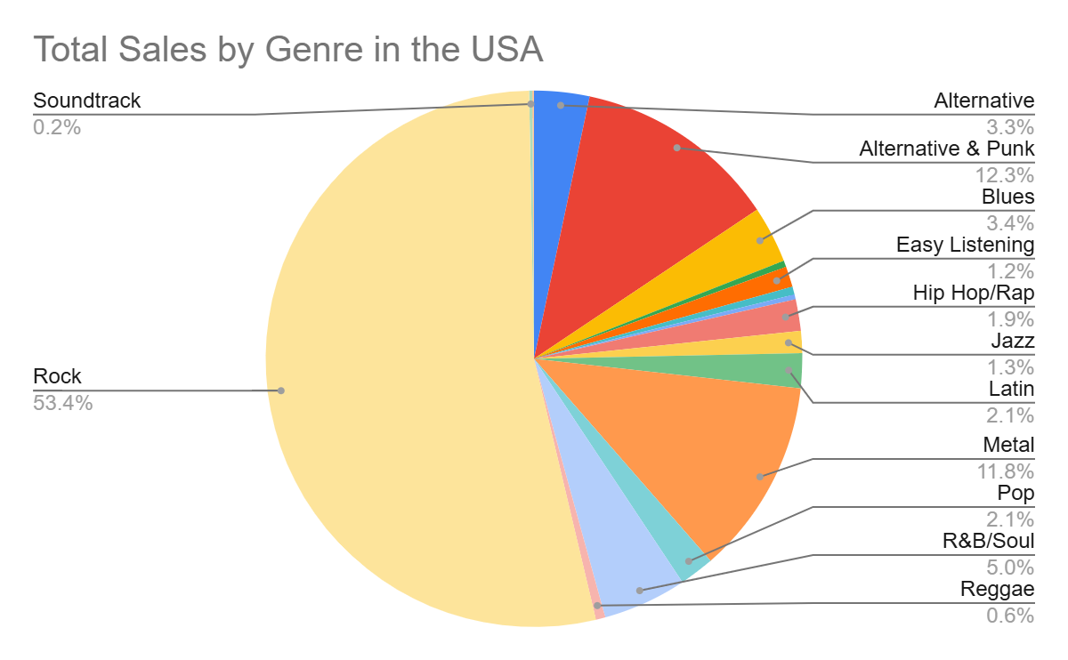
Key Insights From Given Tasks
Percentage of Total Sales by Genre in the USA
Rock dominates the market with 53.43% of total track sales over half of all music sales.
Alternative & Punk (12.29%) and Metal (11.81%) are also strong performers, making up nearly a quarter combined.
R&B/Soul (5.05%) and Blues (3.43%) show moderate popularity.
.

Slide 13
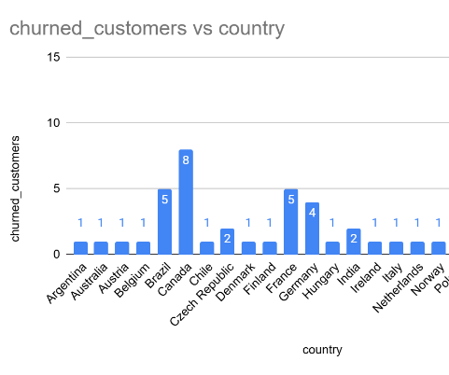
Key Insights From Given Tasks
1. 100% churn rate in all countries in our output.
2. Indicates no active customers remaining who’ve purchased in the last year.
3. May suggest either:
Data is historical or outdated or poor customer retention strategy .

Slide 14
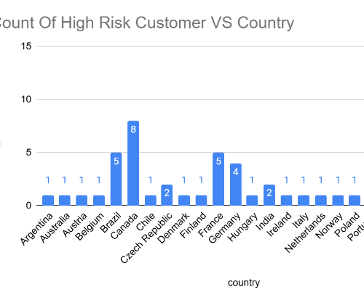
Key Insights From Given Tasks
Customers from these countries were once valuable but have not made a purchase in 4–6 years.
Hence, location is a strong indicator of potential churn, especially from countries with older customer acquisition.

Slide 15
Personalized Recommendations
Utilize product affinity insights to recommend tracks or albums frequently purchased together by customers with similar profiles.
Leverage historical genre preferences to suggest new releases or comparable artists tailored to individual tastes.
Targeted Promotions by Geography
Customize promotional strategies for high-engagement areas (e.g., USA, Canada) through exclusive or premium offerings.
Implement test campaigns in lower-engagement or smaller regions (e.g., genre-specific bundles) to stimulate customer interest.
Monitor Churn Metrics & Early Warning
Regularly observe churn-related signals (e.g., number of days since last transaction exceeding a defined threshold).
Set up automated notifications to alert the marketing team when a formerly active, high-value customer becomes inactive.

Slide 16
Conclusion
Verified data integrity to support accurate and dependable analysis.
Highlighted leading tracks, artists, and genres to inform promotional strategies.
Assessed customer churn and lifetime value to better focus retention initiatives.
Revealed product associations and regional trends to enhance cross-selling opportunities.
Proposed practical strategies including loyalty initiatives, reactivation campaigns, region-specific marketing, and performance tracking dashboards.

Slide 17
THANK YOU

